Slide 1

GREEN DATA STORAGE

Slide 2
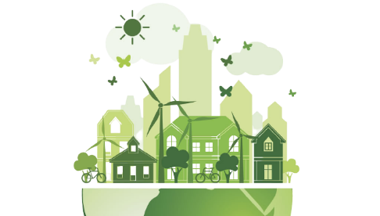
INTRODUCTION
What is green data storage?
- Green storage is the practice of using a variety of "clean energy" storage methods and products to cut down on a data centre’s Carbon Footprint as well as the cost.
A green data center is an enterprise class computing facility that is entirely managed and operated on the principles of green computing. It comes with the same features and capabilities of a typical data center but uses less energy and space, and also its design and operation are environment friendly.
What exactly is Carbon Footprint ?
- A carbon footprint is the amount of greenhouse gases—primarily carbon dioxide—released into the atmosphere by a particular human activity.
It is usually measured as tons of CO₂ emitted per year, a number that can be supplemented by tons of CO₂-equivalent gases, including methane, nitrous oxide, and other greenhouse gases.

Slide 3

So, what is the relation between storing data and Carbon footprint?
- Producing electricity consumed by data centers will result in the release of 100 million metric tons of carbon dioxide (CO2) by 2020.
In 2018, Google estimated that one month of a typical individual’s emailing and searching adds up to about the same greenhouse gas emissions as driving a car 1.6 km.
Fun Fact:
Every Google search comes at a cost to the planet. In processing 3.5 billion searches a day, the world’s most popular website accounts for about 40% of the internet’s carbon footprint.

Slide 4

ADVANTAGES
Reduced Impact on Environment
- The green or sustainable data centers reduce the energy consumption and exert less impact on environment as compared to the traditional ones.
Decreased Capital Expenditure
- Green or environment-friendly data centers use the minimum amount of power thanks to continuous monitoring and effective data management services.

Slide 5

Effectiveness
- The green data center can offer up to 60% savings in hardware cost and a 32% increase in PUE (Power Usage Effectiveness).
Turning Off Unused Servers
- The green data centers can turn these servers off and reduces the energy consumption and cost.

Slide 6

IMPORTANCE
Green storage protect the environment like mentioned.
The service utilizes environmentally friendly solar panels meeting optimal energy efficient standard.
Green units use smart technologies to keep your items safe and dry no matter what season it is because of that system

Slide 7

They usually incorporate a self sustainable power system that save money so other benefits.they usually incorporate a self sustainable power system that save money so other benefits.
A number of technologies had been recognised as effective ways to adapt energy
The use of cloud storage improve capacity system better performance oriented technology

Slide 8
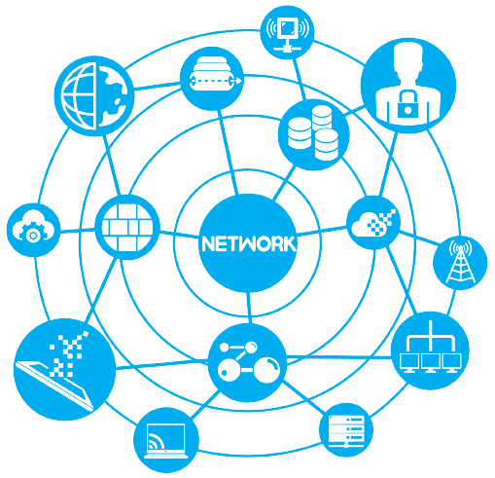
PROBLEM SOLVED BY G.D.S
Reduced cooling requirements
There are a number of factors for improving power and cooling efficiency by reducing the heat generated in the data center with water or refrig-errant heat exchangers
Increasing facilities system efficiency
Replacing chiller or UPS systems that have been in service for 15 years or more can result in substantial savings.
Reduced power consumption with innovative technologies
replacing older IT equipment with newer models can significantly reduce
overall power and cooling requirements reduced by 25 to 40 percent over older(1U) technologies.

Slide 9
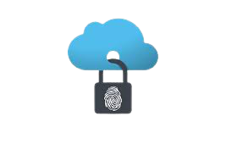
Virtualization
This eliminates the approach
of dedicating a single workload to a single server—a practice that yields low
utilization rates—and allows virtualized servers to function near maximum
Power management in IT systems
Ideally, power usage in a data center should be proportional to the workload.
The amount of
power used by a single server or groups of servers can be capped
to optimize energy use and application performance without sacrificing productivity.

Slide 10

TECHNOLOGY
Data centers throughout Europe are leading the charge in efficient energy practices and renewable energy.
When you think of spring, you think of good weather and the color green. But today, the color green has taken on a brand-new significance as the symbol of the booming green energy movement. That has become a vital component of Europe’s economy.
Data centers throughout Europe are leading the charge in both efficient energy practices and the use of renewable energy, showing that being green is a crucial way to win customers in Europe.

Slide 11

Demonstrating green practices can be a notable business differentiator for service providers looking to sell services to the European market.
Europeans care strongly about sustainability: slightly more than eight in ten EU citizens felt that environmental impact was an important element when deciding which products to buy.
So, data centers have been implementing energy-saving designs and harnessing everything from arctic winds to underground aquifers to the Baltic Sea to reduce energy use and thus reduce their carbon footprint.
.So, for US companies trying to take advantage of the European market, colocating in data centers committed to both using green technology and innovating new efficiency measures is a way to distinguish themselves from their competitors.

Slide 12
CONCLUSION
Green storage is the practice of using a variety of "clean energy" storage methods and products to cut down on a data centre’s Carbon Footprint as well as the cost.
A carbon footprint is the amount of greenhouse gases—primarily carbon dioxide released into the atmosphere by a particular human activity.
Green storage protect the environment like mentioned above
Increasing facilities system efficiency, Reduced power consumption with innovative technologies

Slide 13
BSCIT Group-6
YAJAT DALVI – 08
DEEPAK YADAV – 105
GAURAV THAKUR – 94
BHAVIN NOR – 54
SAEED SHAIKH – 131
RAJ NAIK - 50

Slide 14
THANKYOU!

